Slide 1
EEE 109 Electrical Circuits
Dr. Md. Forkan Uddin
Associate Professor
Department of Electrical and Electronic Engineering (EEE)
Bangladesh University of Engineering and Technology (BUET)

Slide 2
Series-Parallel Circuits
Boylestad – Chapter 7

Slide 3
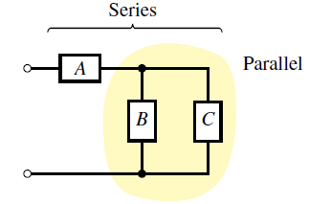
Series-Parallel Circuits
Series-parallel networks are networks that –
contain both series and parallel circuit configurations

Slide 4
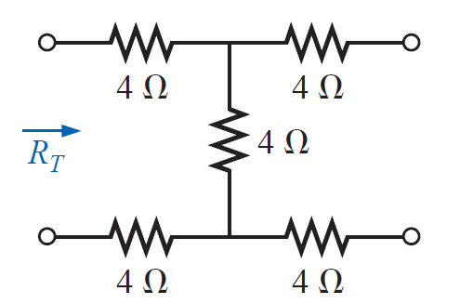
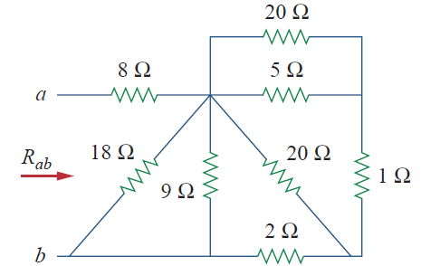
Equivalent / Total Resistance
Example 1
Ans: 12 ohm
Example 2
Ans: 11 ohm

Slide 5
Example: Series-Parallel Circuits
Example 3
Use “Reduce and Return” Approach
Ans:
I_{A} = 3A, I_{B} = 1 A, I_{C} = 2 A
I₁ = 1.2 A, I₂ = 1.8 A

Slide 6
Example: Series-Parallel Circuits
Example 4
Ans:
V₁ = 7.5 V, V₃ = 9 V, Vab = 1.5 V
I_{S} = 3 A

Slide 7
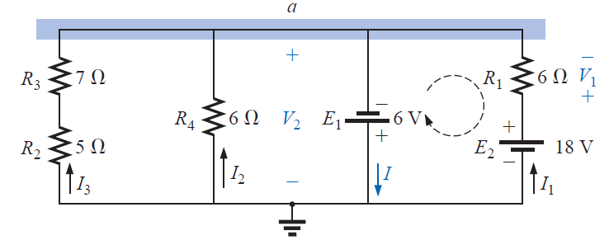
Example: Series-Parallel Circuits
Example 5
Ans:
V₁ = 24 V, V₂ = - 6 V
I = 5.5 A

Slide 8
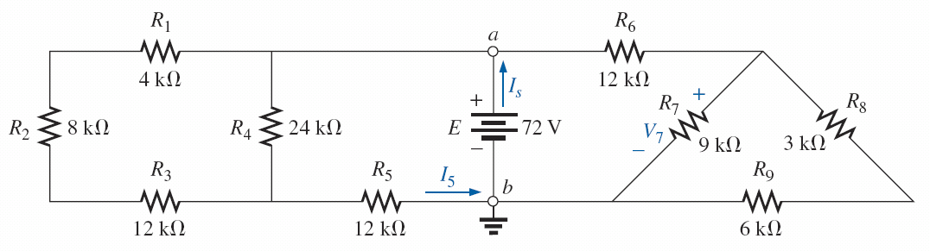
Example: Series-Parallel Circuits
Example 6
Ans:
I₅ = 3 mA, I_{S} = 7.35 mA, V₇ = 19.6 V

Slide 9
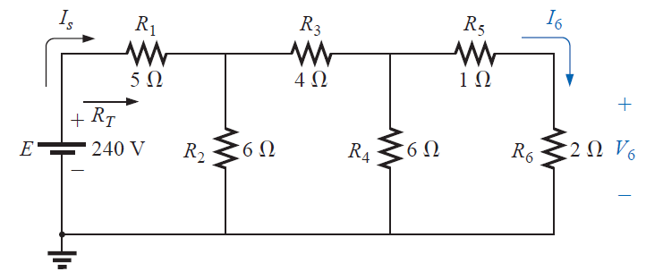
Example: Series-Parallel Circuits
Example 7
3-Stage Ladder Network
Ans:
I₆ = 10 A, V₆ = 20 V

Slide 10
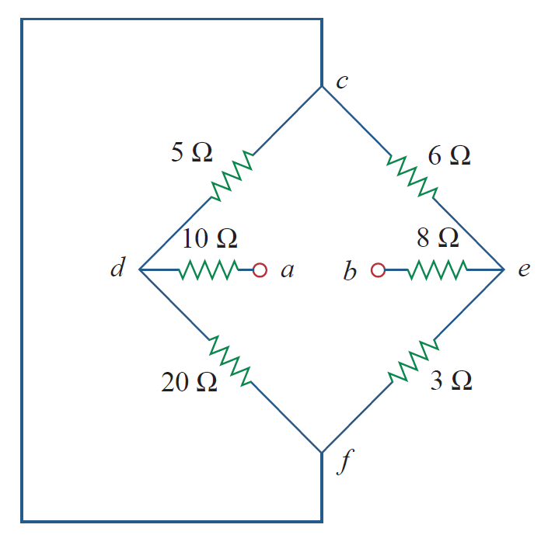
Example: Complex Circuit of R_{eq}
Example 9

Slide 11
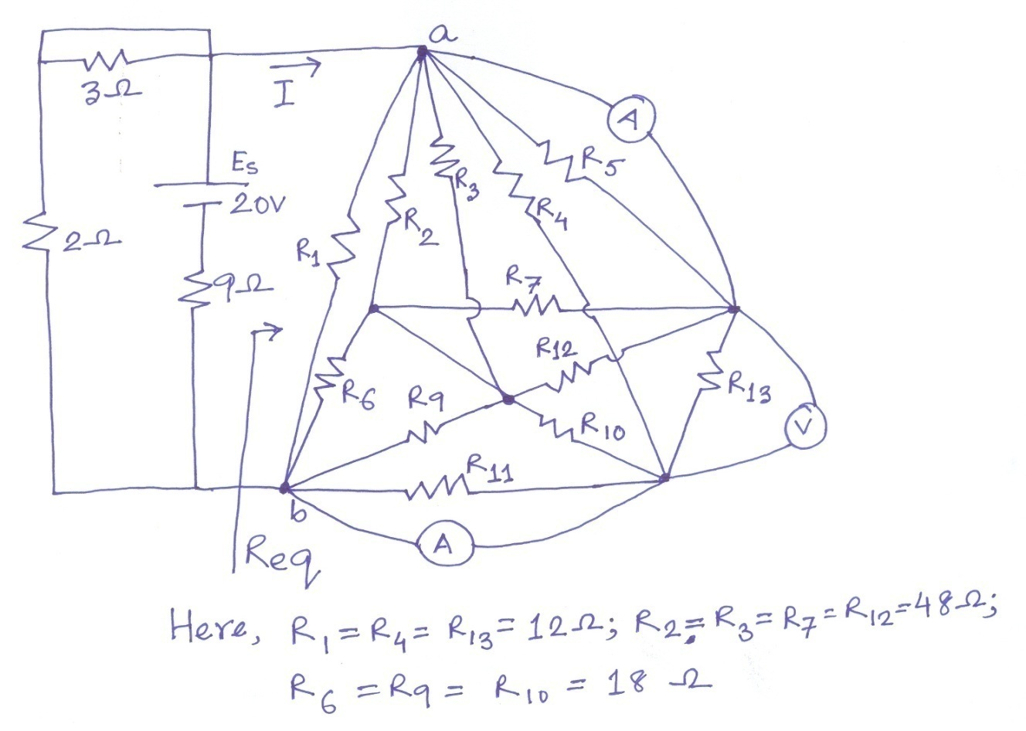
Example: Complex Circuit of R_{eq}
Example 10
For the following circuit, calculate the value of R_{eq}, I and power delivered by the source E_{S}. Assume the ammeters and voltmeters used in the circuit are ideal.

